Slide 1
Detecting Brain Tumours
Joel Koch and Bastian Schuchardt

Slide 2

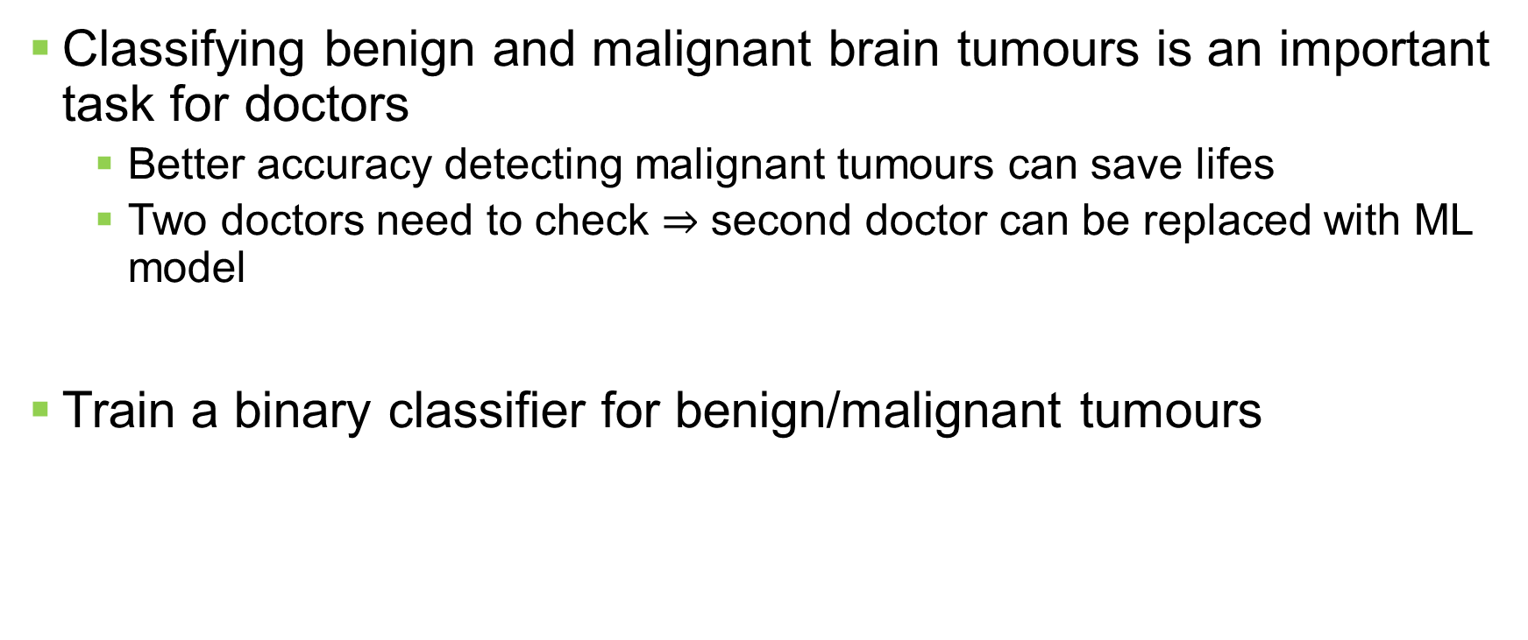
Motivation
Classifying benign and malignant brain tumours is an important task for doctors
Better accuracy detecting malignant tumours can save lifes
Two doctors need to check $⇒$ second doctor can be replaced with ML model
Train a binary classifier for benign/malignant tumours

Slide 3
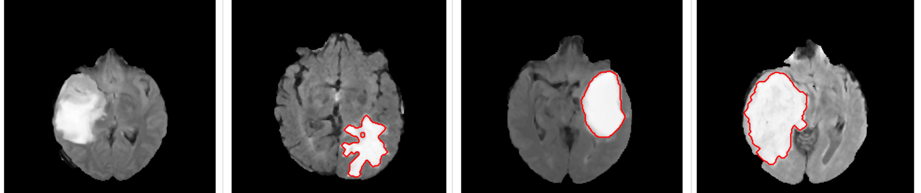
Dataset
“Brain Tumor“ kaggle dataset
3762 images with labels
First order features:
Mean, variance, standard deviation, skweness, kurtosis
Second order features:
Contrast, energy, ASM (angular second moment), entropy, homogenity, dissimilarity, correlation, coarseness
DOI: 10.34740/KAGGLE/DSV/1370629
License: CC BY-NC-SA 4.0

Slide 4
Strategy
Models that can be used
Random forest
Support vector machine
Logistic regression
K-nearest neighbours
Deep learning using a neural network (expected to perform the best)
Evaluation
Accuracy
ROC curve and area under curve (AUC)

